Slide 1
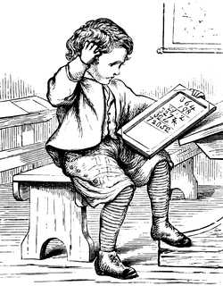
Connotative Language
My teacher says my mind is a blank slate.
Key Component in Inferring Meaning
from Texts or Speech

Slide 2
Denotation and Connotation
Denotation is the literal meaning of a word.
Connotation is created when you say a word and mean something else or something more, something that initially might be hidden or not obvious.
Based on implication, or shared emotional association with a word.

Slide 3
Denotative Meanings
The denotative meaning of a word is similar to the meaning one will find in a dictionary; it is the literal definition of the word.
Example: The denotative meaning of puppy might be ‘ An immature member of the canine species, usually under one year old,” or “ a very young dog”.
Notes:
Ask students to give you the denotative meaning of ‘war’, answers should be attempts at definitions, such as a conflict backed by military and political forces between two or more countries or opposing political forces in one country.

Slide 4
Connotative Meanings
According to literarydevices.com, “Connotation refers to a meaning that is implied by a word apart from the thing which it describes explicitly.
Connotative words carry cultural and emotional associations or meanings in addition to their literal meanings, or denotations.
Connotations typically are positive or negative:
-change vs. transform
-relaxed or easy-going vs. laid back
-pleasantly plump or chubby vs. obese
-slim or svelte vs. skinny
Notes:
Examples: For instance, “Wall Street” literally means a street situated in Lower Manhattan but connotatively it refers to “wealth” and “power”.

Slide 5
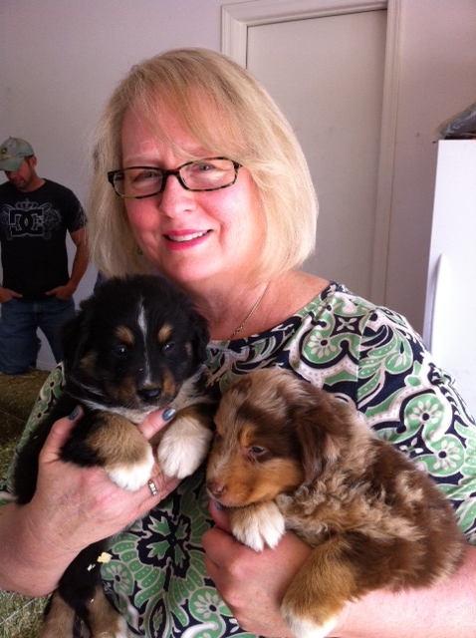
What connotations does the word ‘puppy’ have for you?
In other words, what does the word ‘puppy’ imply to you?
What cultural or emotional associations do you have with the word ‘puppy’?
That is, in your culture, what were you brought up to believe about puppies?
Do you have any memories involving puppies that create emotional response?
Notes:
Students in the United States culture frequently say “dogs are a man’s best friend”, the media frequently portray puppies as fluffy, fun, bundles of joy, etc. Depending on individuals personal experiences with puppies, however, the emotional response may be one of delight, disgust, or neutrality
Have students pair-share or write the answers to these questions, and then have groups share to the whole class.

Slide 6
Keeping in mind the connotations the word ‘puppy’ has for you, interpret these sentences:
“My blind date last night was a puppy.”
“My blind date followed me around like a puppy.”
Notes:
Was he extremely young? Did he look like a dog? Was he foolish and unsophisticated? Or was he over-eager to please? Did he seem loyal and trusting? Cuddly and adoring?

Slide 7
The connotations of “puppy” depend on your culture, experiences, values, and beliefs
Are puppies cute, loving, and cuddly?
Or are they stinky and destructive?
Are they a symbol of a fun-filled childhood or a loyal friend?
Does the word remind you of an injury you once received from a dog?
Are dogs considered offensive or dangerous in your culture?
Most animals have different connotations to different people
Notes:
Briefly discuss pigs, which can be thought of as greedy, dirty, intelligent, capitalist, symbols of police officers, etc.

Slide 8
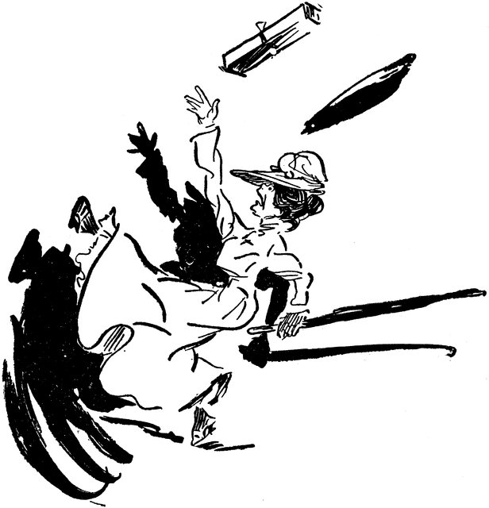
Descriptive verbs can be highly connotative.
I neglected to bring my jump drive to class today.
I forgot to bring my jump drive to class today.
I really slipped up when I left my jump drive in my computer at home.
“Their confidence takes a beating.”
(This is personification. Confidence cannot literally be beaten!)

Slide 9
Connotations of “rat race”
Now consider the connotations of the phrase “rat race”
“The rat race just isn’t for me.”
Do you imagine two children having a great time seeing which of their pet rats runs more quickly?
Or do you visualize a rat frantically running on a wheel inside a wire cage?
Notes:
You might want to point out now that “rat race” is a metaphor, and metaphors are one kind of connotation.
If students indicate that the second situation is what comes to mind, ask them to visualize and describe what’s happening to the rat. (it’s caged in a tight area, it looks uncomfortable, it looks pitiful, it’s going nowhere, it’s after something it cannot get, etc.)
Pair share, or write and share with whole class

Slide 10
Typically the phrase “rat race” is a metaphor for a life filled with pointless competition at work that will never result in achieving a real goal, just as a rat running on a wheel never really gets anywhere in spite of its frenetic efforts.
Notes:
With this phrase, human beings are reduced to pitiful animals who are oblivious to the future disappointing outcome of their efforts
Ask students what similarities there are between a rat on a wheel and a person working incessantly to get ahead

Slide 11
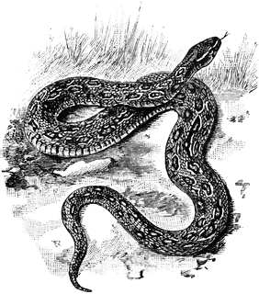
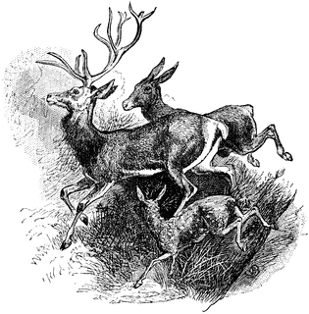
Metaphors describe one thing as the same as something completely different from it. (One thing IS another.) Similes describe two dissimilar entities or ideas as similar by using the words “like” or “as.”
Man, he is a real snake.
The girls do not generally run through the halls like wild animals.

Slide 12
More Figures of Speech
Metaphor – a comparison that indicates two dissimilar things are the same.
Personification – attributing human characteristics to a nonhuman entity.
But these explanations for a continued failure to break the glass ceiling are missing something more basic: women’s acute lack of confidence.
(Women can see the opportunity or get close to it, but can’t rise to that level of opportunity. The obstacle isn’t literally a glass ceiling, but the concrete description makes the obstacle more clear.)
“It was only a matter of time before one of his ideas would strike the right note.”
(An idea can’t literally strike a note, but a person can!)

Slide 13
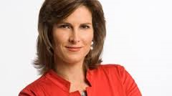
“The Confidence Gap”
Katty Kay
Claire Shipman
BBC World News
ABC News

Slide 14
Connotation example from The Atlantic “The Confidence Gap”
“Half a century since women first forced open the boardroom doors, our career trajectories still look very different than men’s (Kay and Shipman para. 4).
Why did Kay and Shipman use the verb forced?
What effect were they after?
How does changing the verb phrase in this sentence create a different connotation?
Half a century since women were allowed to enter boardroom doors, our career trajectories still look very different from men’s.

Slide 15
EXERCISE: Connotative Language in “The Confidence Gap” 1. Scan “The Confidence Gap” for connotative words or phrases, including figures of speech (such as metaphors, similes, personification) and list them below. 2. Each person should take responsibility for a page range, but you should consult each other. 3. Make a note whether the connotation is positive (+) or minus (-) or a figure of speech. 4. Be sure you can explain the connotation behind the word or figure of speech when you report out.
Pages 1-3 | Pages 4-7 | Pages 8-10 | Pages 11-13
forced open + p. 1

Slide 16
Wrap Up
De-brief examples from the text.
What did you learn from this exercise?
For Monday:
Bring “The Confidence Gap” and your mindset articles. Think about how the information in the article might matter in psychology, communications, business, and health.
Re-read the page 6-7 of “The Confidence Gap” on external and internal attribution. How can being aware of mindset and internal vs. external attributions lead to more success in your personal life and career?
Notes:
Wasted, hammered, wrecked, plastered, destroyed, all have negative connotations that reveal how damaging excessive consumption of alcohol is.

