Slide 1
Connotations vs. Denotations
Instructor Cameron

Slide 2
IMPORTANT INFO
Connotation and denotation are not two separate things.
They are two aspects/elements of a sign, and the connotative meanings of a word exist together with the denotative meanings.
Connotation = the various social overtones, cultural implications, or emotional meanings associated with a sign.
Denotation =the explicit or referential meaning of a sign, the literal meaning of a word, the ‘dictionary definition.’

Slide 3
Consider the difference between these two words:
House/Home
Woman/Chick
Kill/Murder

Slide 4
Joey Writes a Letter…

Slide 5
Denotation vs. Connotation
“Walk” means to move forward by placing one foot in front of the other.
swaggered
strolled
lumbered along
skipped

Slide 6
Which word in each pair below has the more favorable connotation to you?
thrifty-penny-pinching
pushy-aggressive
politician-statesman
chef-cook
slender-skinny
Connotation can depend on the person who hears the word.

Slide 7
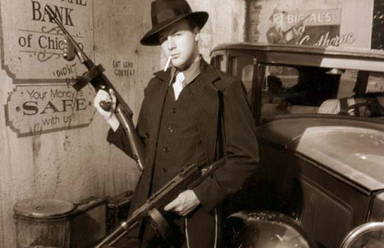
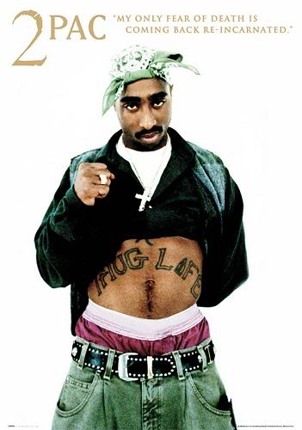
Language is continually changing…
Gangsters and thugs= criminals
During the Depression Irish,
Italian, or other European
immigrants associated with the mob
Today African-American rap artists

Slide 8
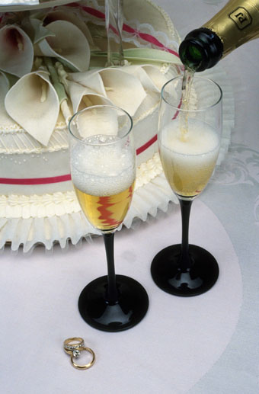
Do these words have positive or negative connotations for “drink”?
guzzle
Slurp
Indulge
sip
lap
down

Slide 9
New Team Names
Poodles
Snakes
Maggots
Hippos
Gazelles
Meteors
Sleepers
Zeniths
Toads
Snails
Spikes
Sloths

Slide 10
 | Negative | Positive
drug addict | druggie/fiend | substance abuser
handicapped | crippled | disabled
thin | beanpole | slender
attractive | fair | pretty
reporter | newshound | journalist
photographer | paparazzi | shutterbug

Slide 11
Positive or Negative?
refreshing-chilly
plain-natural
clever-sly
cackle-giggle
snob-cultured
cop-officer
skinny-slender
statesman-politician
smile-smirk
domineering-assertive

Slide 12
Positive or Negative?
refreshing-chilly
plain-natural
clever-sly
cackle-giggle
snob-cultured
cop-officer
skinny-slender
statesman-politician
smile-smirk
domineering-assertive

Slide 13
 | Negative | Positive
Over-weight
Short
Not smart
Unattractive
Non-athletic
Self-focused

Slide 14
Consider the following:
There are over 2,000 vagrants in the city.
There are over 2,000 people with no fixed address in the city.
There are over 2,000 homeless in the city.

Slide 15
What’s the Difference?
The media were swarming around the pileup on the expressway to capture every conceivable injury for the evening news.
The journalists were on the scene at the expressway crash to document the incident for the evening news.

Slide 16
Photographers stood patiently along the walkway, awaiting the arrival of the Oscar nominees.
The paparazzi lined the walkway anxiously poised to snap the Oscar nominees.

Slide 17
America's Midwest is often referred to as the heartland by Washington congressmen.
America's Midwest is often referred to as flyover country by DC politicos.

Slide 18
What’s the POINT?
Separating grammatical denotation from connotation is important because while one might assume that a word’s denotation is fully intended, whether a word’s connotations are intended is much more difficult to determine.
Connotations are often emotional in nature, and thus if they are intended, it may be for the purpose of swaying a person’s emotional reactions rather than the logical evaluation of an argument.

