Slide 1
Reading 091 Nonverbal Communication

Slide 2
AGENDA
Nonverbal Communication video examples and Satir’s Communication Stances
Essential Question: How are physical gestures and verbal expressions linked?
What does current the brain science teach us about this?
Article Review: “Gestures Offer Insight” from Scientific American Mind (Note: full article available through Academic Search Premier library database)
Reading Skill: mapping the overall idea, the key supporting points/ideas/reasons, and the supporting details/examples/evidence.
Homework: Read, annotate, and take notes on Ch. 1 What is Marketing? for class next Tuesday

Slide 3
Nonverbal Communication Styles: How do we use nonverbal communication in our everyday lives?
Communication Styles as seen in Friends:
http://www.youtube.com/watch?v=OvEci5Bjgd4
Virginia Satir’s Communication Stances
http://www.catherineshafer.com/satir.html
http://changingminds.org/techniques/body/satir_five_positions.htm
Why should you know more about non-verbal communication?
How can your knowledge of nonverbal question make a difference in your life?

Slide 4
Annotating your “Gestures Offer Insight” Article
Overall Main Idea: overarching main idea, thesis statement, argumentative claim, key claim. Some times the overall main idea is not stated, but in most informational texts it is. If a main idea is communicated not stated directly, it is an implied overall main idea.
Supporting Main Ideas: major ideas that support or help develop the author’s overall main idea, thesis, claim (like section and paragraph topic sentences). Sometimes these supporting main ideas are not stated directly; they are implied and you must infer them from the text presented.
Supporting Evidence/Detail: major and minor details, examples, research studies, facts, description, narrative examples.
Supporting Explanation: commentary, explanation of major or minor details; explains the relationship of evidence to the supporting or overall main idea.

Slide 5
Reviewing your annotations
Follow the model on the doc camera.

Slide 6
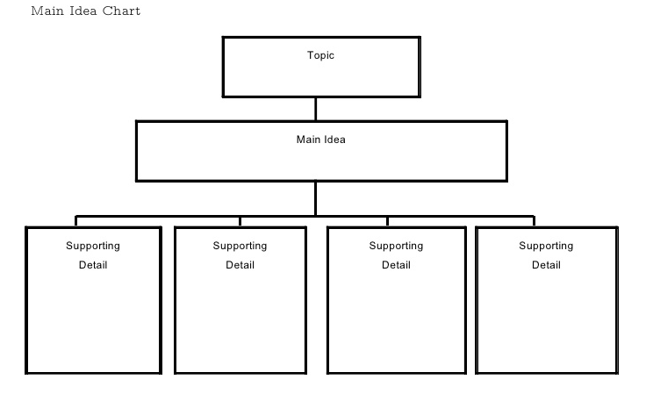
Exercise: Mapping the main and supporting ideas and evidence.
Main Idea
Add Main Idea Blocks as Needed

Slide 7
De-brief Mapping Activity and Homework
Homework: Read, annotate, and take notes on Ch. 1 What is Marketing? for class next Tuesday
As you read your homework, annotate your text for:
overall main idea/claim/thesis
key supporting ideas, and
details and evidence including /examples/facts that support those ideas or the overall main idea (thesis/claim).
This means you will label every paragraph in the selection. Re-phrasing the point of each paragraph in your label will help you figure out the purpose of that paragraph and/or section of the article.

