Slide 1
Reading 091
External Textbook Features
Textbook Analysis Project/Paper

Slide 2
SAMPLE Agenda
Today’s Objective: Learn how external textbook features facilitate your academic reading comprehension and study skills.
Analyzing a print college textbook’s front matter and back matter features.
Analyzing a print college textbook’s external features within a chapter.
NEXT CLASS: Analyzing a online textbook chapter (the first in our Communications Unit). BRING YOUR PRINT TEXTBOOK ON WEDNESDAY AS WELL.

Slide 3
OVERVEIW: Your Textbook Analysis Project
Textbook structures matter.
Related RDG 100 competencies:
Prompt reviewed.
Today’s notebook exercises completed.
Your textbook analysis in process compared.
The assignment and rubric reviewed.
Today’s content de-briefed.

Slide 4
Text Organization and Its Relationship to Reading Comprehension
Well-presented physical text facilitates reading comprehension.
Text structure and student awareness of text structure are highly related to reading comprehension.**
Explicit instruction in the physical presentation of text and/or text structure facilitates reading comprehension.
That’s what we are doing with the textbook project!
**-from Text Organization and Its Relation to Reading Comprehension: A Synthesis of Research, Shirley V. Dickson, Deborah C. Simmons, and Edward J. Kameenui, University of Oregon

Slide 5
TEXTBOOK PROJECT PROMPT: Your mission is to explain, in an organized process essay, to a person like yourself how to use your college textbook to the fullest advantage. (It is acceptable to use the second person “you” in this paper since you are telling someone how to do something. However, your writing should be carefully proofread,)

Slide 6
Key Vocabulary
External structures – the way the text is physically presented; today’s focus is on these physical text features/structures.
Internal structures – the way the actual content is developed through organizational patterns of development such as cause/effect, comparison/contrast, definition, etc.
In your today’s lesson, you will focus on external structures.

Slide 7
Key Vocabulary
Front Matter: The content typically found in the front of a book (table of contents, preface, directions for using the book).
Back Matter: The content
Skimming: The practice of moving eyes over text quickly to get an overview and main ideas of the text.
Scanning: The practice of reading texts very quickly to find a particular piece of information.
This is where “control-f” (PC) or “command-f” (Mac) comes in handy in the digital age!

Slide 8
Take a “big picture” look at your textbook: Physical Text Features that Facilitate Learning
Title and Type of Source (book, magazine, online source) layout
Target audience
Publishing Information
Authors/editors; author bio and background notes
Preface
Table of Contents
Glossary
Index
Headings
Subheadings
Questions
Summaries
Auxiliary content such as additional text boxes, maps, online links, quotations from the text or elsewhere, images, charts, diagrams, etc.
References
You probably can find others!

Slide 9
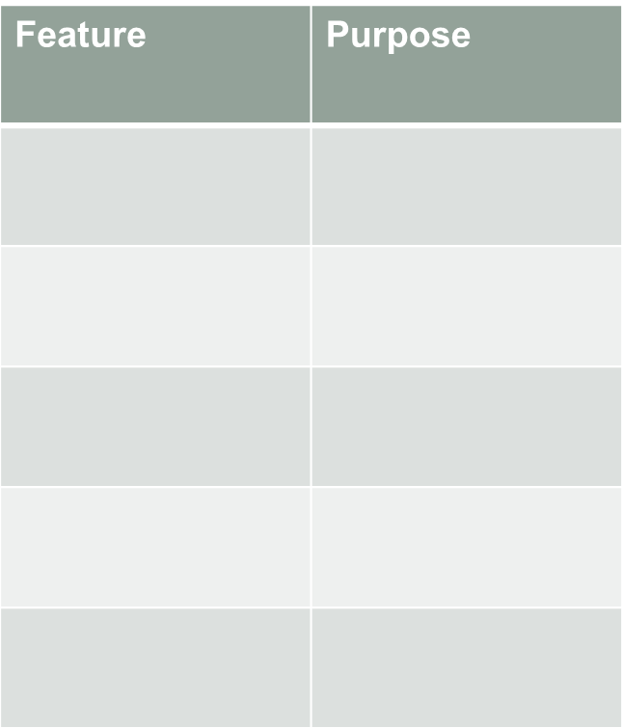
Notebook Entry: External Features 10/13
Front Matter
Back Matter
Feature | Purpose*
*How does this feature help me read, comprehend, and learn the material?

Slide 10
Consistent External Features within Chapters that Facilitate Reading and Learning
Headings
Subheadings
Questions
Summaries
Auxiliary content such as additional text boxes, maps, online links, quotations from the text or elsewhere, images, charts, diagrams, etc.
References
You probably can find others!
Chapter Analysis
How do the external text features organize the chapter?
Explain how that facilitates your reading.

Slide 11
External Text Features within Chapters (Try for 8-10!)
Feature | Purpose*
*How does this feature help me read, comprehend, and learn the material?

Slide 12
Here’s the textbook project outline:
Introduce the textbook to your fellow student and give a rationale for using the textbook to actively engage with related course content.
Explain the external structures of the textbook (not within the chapters) and how they support learning of the material. Be very specific and give examples. Critique the quality of these structures so your fellow student will know what to expect.
Select a chapter to analyze more fully. What external structures organize the chapter to help students read effectively, learn, and review the content? How will you explain this to another student?
Write a conclusion to the paper.

Slide 13
Group De-brief
What did you and your group members learn through this exercise?
What did you learn that might help you with reading and learning from textbooks in the future?
Prepare to report out: each group member needs to be prepared to be called on to report his or her group’s responses to the questions above.

Slide 14
HOMEWORK
Start organizing and adding to the content you selected from your book today to meet the criteria of the textbook paper project.
Textbook Analysis Paper Project DUE _____ at the beginning of the period in hard copy print out. You can print your paper for free (unless you’ve used your allotment) at any of the labs on campus.
Download the Word Document from Canvas.
Sign up with a Writing Center tutor, a free service, to help you proofread your paper.
Come to my office hours or make an appointment if you need additional coaching on this assignment.

